Slide 1
Swing Containers and Components
Appendix D
Sun Certified Java Programmer Workshop

Slide 2
Contents
Using panes
Creating components
Demo project: DemoSwingContainersComponents

Slide 3
1. Using Panes
Overview of panes
Using JPanel
Using JScrollPane
Using JSplitPane
Using JToolBar
Using JTabbedPane

Slide 4
Overview of Panes
Panes provide areas of "real estate" on a top level window
Each frame has a content pane
There are several pane classes available
JPanel is the simplest ☺
We'll investigate the various panel classes in this section
See the PaneDemo.java sample code

Slide 5
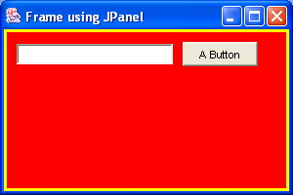
Using JPanel
This example shows how to create and use a simple JPanel pane in a frame window
public void demoJPanel() {
// Create a JFrame and a JPanel.
JFrame frame = new JFrame("Frame using JPanel");
JPanel pane = new JPanel();
// Configure the JPanel as you like.
pane.setBackground(Color.red);
pane.setBorder(BorderFactory.createLineBorder(Color.yellow, 3));
pane.setLayout(new FlowLayout(FlowLayout.LEFT, 10, 10));
// Add components to the JPanel.
pane.add(new JTextField(20));
pane.add(new JButton("A Button"));
// Add JPanel to "content pane" of Jframe.
frame.getContentPane().add(pane);
// Display the frame.
frame.setSize(300, 200);
frame.setVisible(true);
}

Slide 6
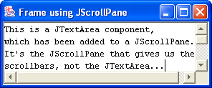
Using JScrollPane
JScrollPane provides a scrollable view of a component
Adds scrollable behaviour to components
public void demoJScrollPane() {
JFrame frame = new JFrame("Frame using JScrollPane");
frame.setDefaultCloseOperation(JFrame.EXIT_ON_CLOSE);
// Create a JTextArea, and wrap it in a JScrollPane.
JTextArea textarea = new JTextArea(10, 30);
JScrollPane pane = new JScrollPane(textarea);
// Add JScrollPane to "content pane" of Jframe.
frame.getContentPane().add(pane);
// Display the frame.
frame.setSize(300, 100);
frame.setVisible(true);
}

Slide 7
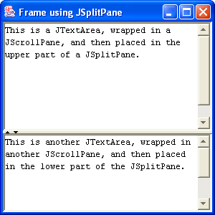
Using JSplitPane
JSplitPane divides two (and only two) components
Split horizontally or vertically
public void demoJSplitPane() {
JFrame frame = new JFrame("Frame using JSplitPane");
frame.setDefaultCloseOperation(JFrame.EXIT_ON_CLOSE);
// Create two JTextAreas, and wrap each in its own JScrollPane.
JTextArea textareaT = new JTextArea(10, 30);
JTextArea textareaB = new JTextArea(10, 30);
JScrollPane paneT = new JScrollPane(textareaT);
JScrollPane paneB = new JScrollPane(textareaB);
// Add the two JScrollPanes to a JSplitPane.
JSplitPane splitPane = new JSplitPane(JSplitPane.VERTICAL_SPLIT, paneT, paneB);
// Configure the panes in the JSplitPane.
splitPane.setOneTouchExpandable(true);
splitPane.setDividerLocation(100);
paneT.setMinimumSize(new Dimension(100,50));
paneB.setMinimumSize(new Dimension(100,50));
// Add JSplitPane to frame, and display.
frame.getContentPane().add(splitPane);
frame.setSize(300, 300);
frame.setVisible(true);
}

Slide 8
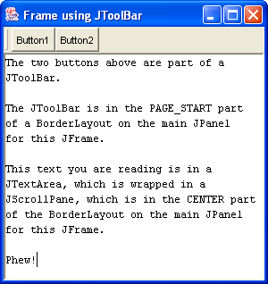
Using JToolBar
JToolBar groups components into a row or column
public void demoJToolBar() {
JFrame frame = new JFrame("Frame using JToolBar");
frame.setDefaultCloseOperation(JFrame.EXIT_ON_CLOSE);
JTextArea textarea = new JTextArea(10, 30);
JScrollPane scrollpane = new JScrollPane(textarea);
JButton button1 = new JButton("Button1");
button1.setActionCommand("OPEN");
button1.setToolTipText("Open a file");
JButton button2 = new JButton("Button2");
button2.setActionCommand("CLOSE");
button2.setToolTipText("Close a file");
JToolBar toolbar = new JToolBar(); // Create toolbar.
toolbar.add(button1); // Add button1.
toolbar.add(button2); // And button2.
JPanel mainpane = new JPanel();
mainpane.setLayout(new BorderLayout());
mainpane.add(toolbar, BorderLayout.PAGE_START);
mainpane.add(scrollpane, BorderLayout.CENTER);
frame.getContentPane().add(mainpane);
frame.setSize(300, 300);
frame.setVisible(true);
}

Slide 9
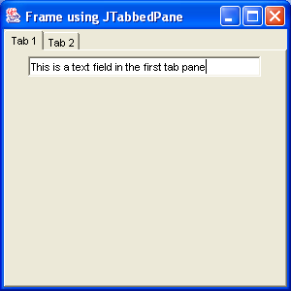
Using JTabbedPane
JTabbedPane displays tabbed panes ☺
public void demoJTabbedPane() {
JFrame frame = new JFrame("Frame using JTabbedPane");
frame.setDefaultCloseOperation(JFrame.EXIT_ON_CLOSE);
// Create components for tab1 (wrap in a JPanel).
JTextField textfield1 = new JTextField(30);
JPanel panel1 = new JPanel();
panel1.add(textfield1);
// Create components for tab2 (wrap in a JPanel).
JButton button2 = new JButton("A button");
JPanel panel2 = new JPanel();
panel2.add(button2);
// Create a JTabbedPane, and add tabs.
JTabbedPane tabbedPane = new JTabbedPane();
tabbedPane.addTab("Tab 1", null, panel1, "Go to tab 1");
tabbedPane.addTab("Tab 2", null, panel2, "Go to tab 2");
// Add JTabbedPane to frame, and display.
frame.getContentPane().add(tabbedPane);
frame.setSize(300, 300);
frame.setVisible(true);
}

Slide 10
2. Creating Components
Overview of components
Text fields and text areas
Push buttons
Check boxes
Radio buttons
Menus
Other controls

Slide 11
Overview of Components
Swing provides a wide range of components
Simple components, such as text boxes and buttons
More interesting components, such as progress bars and sliders
We'll investigate various component classes in this section
See the ComponentDemo.java sample code

Slide 12
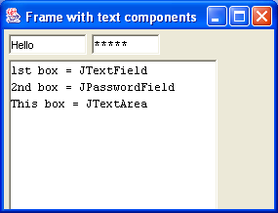
Text Fields and Text Areas
Useful classes:
JTextField = Single line of text
JPasswordField = Single line of text, displays as asterisks
JTextArea = Multiple lines of text
JEditorPane = Multiple lines of text in multiple fonts
public void demoText() {
JFrame frame = new JFrame("Frame with text components");
frame.setDefaultCloseOperation(JFrame.EXIT_ON_CLOSE);
// Create a JPanel, to hold text components.
JPanel pane = new JPanel();
pane.setLayout(new FlowLayout(FlowLayout.LEFT));
// Add text components to JPanel.
pane.add(new JTextField(10));
pane.add(new JPasswordField(10));
JScrollPane scrollpane = new JScrollPane(new JTextArea(30, 30));
pane.add(scrollpane);
// Add JPanel to frame, and display.
frame.getContentPane().add(pane);
frame.setSize(300, 200);
frame.setVisible(true);
}

Slide 13
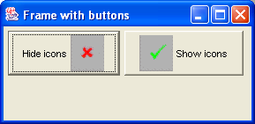
Push Buttons (1 of 2)
Use JButton and handle “action” events (see next slide)
public void demoPushButtons() {
JFrame frame = new JFrame("Frame with buttons");
frame.setDefaultCloseOperation(JFrame.EXIT_ON_CLOSE);
JButton b1 = new JButton("Hide icons", icon1);
b1.setVerticalTextPosition(AbstractButton.CENTER);
b1.setHorizontalTextPosition(AbstractButton.LEADING);
b1.setMnemonic(KeyEvent.VK_H);
b1.setActionCommand("hide");
b1.setToolTipText("Click to hide icons on buttons");
JButton b2 = new JButton("Show icons", icon2);
b2.setVerticalTextPosition(AbstractButton.CENTER);
b2.setHorizontalTextPosition(AbstractButton.TRAILING);
b2.setMnemonic(KeyEvent.VK_S);
b2.setActionCommand("show");
b2.setToolTipText("Click to show icons on buttons");
PushButtonActionListener listener = new PushButtonActionListener(); // See next slide
b1.addActionListener(listener);
b2.addActionListener(listener);
JPanel pane = new JPanel();
pane.setLayout(new FlowLayout(FlowLayout.LEFT));
pane.add(b1);
pane.add(b2);
…

Slide 14
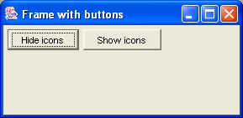
Push Buttons (2 of 2)
Buttons generate "action" events
To handle action events, define a class that implements the ActionListener interface
Implement actionPerformed() to handle the event
// Inner class, to handle ActionEvents for the demoPushButtons() method.
class PushButtonActionListener implements ActionListener {
public void actionPerformed(ActionEvent e) {
if ("hide".equals(e.getActionCommand())) {
b1.setIcon(null);
b2.setIcon(null);
}
else if ("show".equals(e.getActionCommand())) {
b1.setIcon(icon1);
b2.setIcon(icon2);
}
}
}

Slide 15
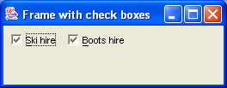
Check Boxes (1 of 2)
Use JCheckBox and listen for "item" events
public void demoCheckBoxes() {
JFrame frame = new JFrame("Frame with check boxes");
frame.setDefaultCloseOperation(JFrame.EXIT_ON_CLOSE);
JCheckBox cb1 = new JCheckBox("Ski hire");
cb1.setMnemonic(KeyEvent.VK_S);
cb1.setSelected(true);
cb1.setToolTipText("Do you require ski hire?");
JCheckBox cb2 = new JCheckBox("Boots hire");
cb2.setMnemonic(KeyEvent.VK_B);
cb2.setSelected(true);
cb2.setToolTipText("Do you require boot hire?");
CheckBoxItemListener listener = new CheckBoxItemListener(); // See next slide.
cb1.addItemListener(listener);
cb2.addItemListener(listener);
JPanel pane = new JPanel();
pane.setLayout(new FlowLayout(FlowLayout.LEFT));
pane.add(cb1);
pane.add(cb2);
…

Slide 16
Check Boxes (2 of 2)
Check boxes generate "item" events
To handle them, define a class that implements ItemListener
Implement itemStateChanged() to handle the event
Handle "item" events:
// Inner class, to handle ItemEvents for the demoCheckBoxes() method.
class CheckBoxItemListener implements ItemListener {
public void itemStateChanged(ItemEvent e) {
Object source = e.getItemSelectable();
String label = "";
if (source == cb1) {
label = cb1.getText();
}
else if (source == cb2) {
label = cb2.getText();
}
if (e.getStateChange() == ItemEvent.SELECTED) {
System.out.println(label + " required");
}
else if (e.getStateChange() == ItemEvent.DESELECTED) {
System.out.println(label + " not required");
}
}
}

Slide 17
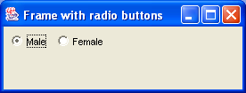
Radio Buttons (1 of 2)
Create group of JRadioButtons, await "action" events
public void demoRadioButtons() {
JFrame frame = new JFrame("Frame with radio buttons");
frame.setDefaultCloseOperation(JFrame.EXIT_ON_CLOSE);
rb1 = new JRadioButton("Male");
rb1.setMnemonic(KeyEvent.VK_M);
rb1.setActionCommand("male");
rb1.setToolTipText("Are you male?");
rb1.setSelected(true);
rb2 = new JRadioButton("Female");
rb2.setMnemonic(KeyEvent.VK_F);
rb2.setActionCommand("female");
rb2.setToolTipText("Are you female?");
RadioButtonActionListener listener = new RadioButtonActionListener(); // Next slide.
rb1.addActionListener(listener);
rb2.addActionListener(listener);
ButtonGroup group = new ButtonGroup();
group.add(rb1);
group.add(rb2);
JPanel pane = new JPanel();
pane.setLayout(new FlowLayout(FlowLayout.LEFT));
pane.add(rb1);
pane.add(rb2);
…

Slide 18
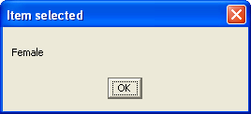
Radio Buttons (2 of 2)
Handle "action" events:
// Inner class, to handle ActionEvents for the demoRadioButtons() method.
class RadioButtonActionListener implements ActionListener {
public void actionPerformed(ActionEvent e) {
if ("male".equals(e.getActionCommand())) {
JOptionPane.showMessageDialog(null,
"Male",
"Item selected",
JOptionPane.PLAIN_MESSAGE);
} else if ("female".equals(e.getActionCommand())) {
JOptionPane.showMessageDialog(null,
"Female",
"Item selected",
JOptionPane.PLAIN_MESSAGE);
}
}
}

Slide 19
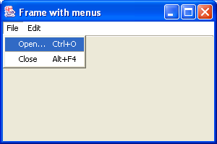
Menus
Use JMenuBar, JMenu, and JMenuItem
public void demoMenus() {
JFrame frame = new JFrame("Frame with menus");
frame.setDefaultCloseOperation(JFrame.EXIT_ON_CLOSE);
JMenuBar menuBar = new JMenuBar();
frame.setJMenuBar(menuBar);
// Create a "File" menu, and add "Open" and "Close" menu items.
JMenu file = new JMenu("File");
file.setMnemonic(KeyEvent.VK_F);
menuBar.add(file);
JMenuItem open = new JMenuItem("Open...", KeyEvent.VK_O);
open.setAccelerator(KeyStroke.getKeyStroke(KeyEvent.VK_O, ActionEvent.CTRL_MASK));
JMenuItem close = new JMenuItem("Close", KeyEvent.VK_C);
close.setAccelerator(KeyStroke.getKeyStroke(KeyEvent.VK_F4, ActionEvent.ALT_MASK));
file.add(open);
file.addSeparator();
file.add(close);
// Now create an "Edit" menu.
JMenu edit = new JMenu("Edit");
edit.setMnemonic(KeyEvent.VK_E);
menuBar.add(edit);
…

Slide 20
Other Controls
JProgressBar
Vertical or horizontal progress indicator
ProgressMonitor
Similar to JProgressBar (but invisible until a task completes)
JSlider
Enables the user to select a numerical value in a specified range
And more…
Lookup JComponent in the Swing API documentation, and find the list of known subclasses

Slide 21
Summary
Using panes
Creating components

